Slide 1
Searching and Sorting

Slide 2
Sorting Arrays
Multiple standard algorithms available
Can utilize one array or two
One array shifts within the current array
Two arrays creates a new array to populate

Slide 3
Selection Sort
Swaps out values
Find the smallest (or largest) value in a list and swaps it to the end
Finds the next smallest (or largest) value in the list and swaps it in the next position
Pattern continues until all items are sorted

Slide 4
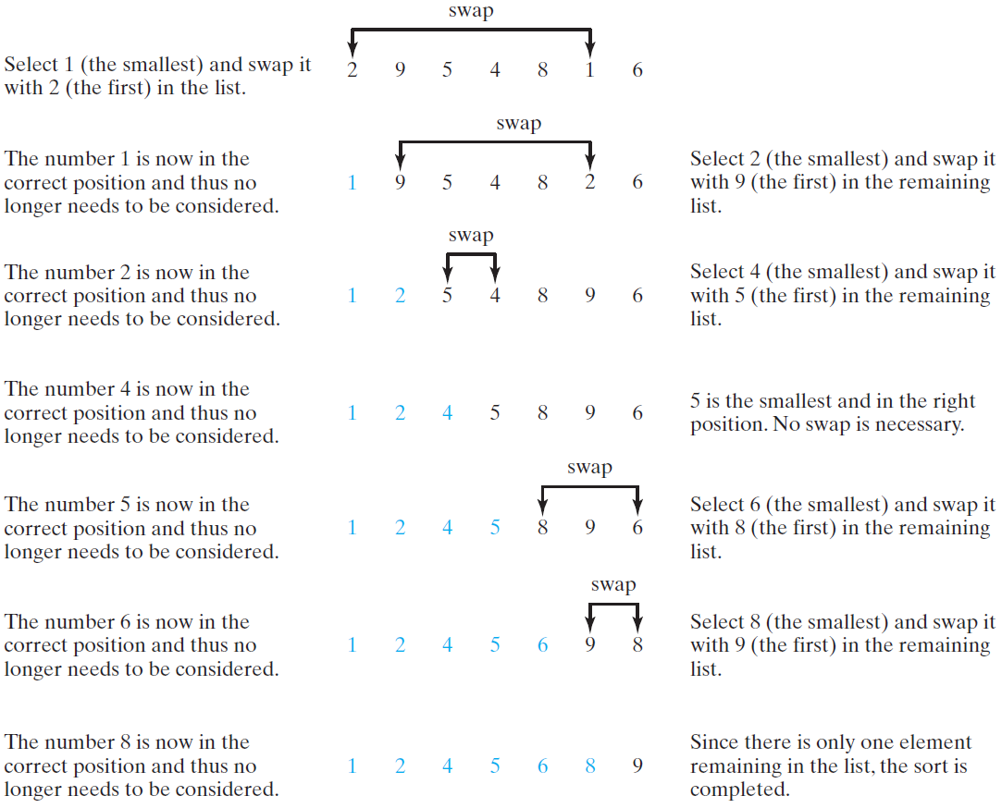
Selection Sort
Selection sort finds the smallest number in the list and places it first. It then finds the smallest number remaining and places it second, and so on until the list contains only a single number.

Slide 5
Insertion Sort
Takes the first element and either sets it aside or places in a new array
Takes the next element and inserts to the left or right of the first element
Takes the next element, looks for a value higher (or lower) and inserts the new value
Pattern continues until all items are sorted

Slide 6
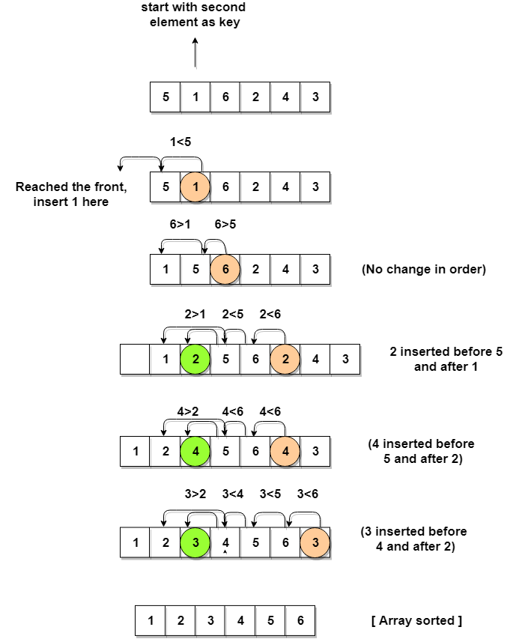
Insertion Sort
Insertion sort sets aside the first element or inserts it into a new array. The sort starts with the second element in the array, which is then compared to the first element to the left. If the second value is less than the first element, it is inserted before the first element. If it is greater, then it is inserted after the first element.
The third element is then compared to the element to the left and inserted into the left or the right, just as the first one was inserted. This pattern continues until all values are inserted.

Slide 7
Merge Sort
Breaks the array down recursively until the array is divided into a series of single item arrays
The base case is when the array is broken down
The program recursively uses an insertion sort to resort the elements and reassemble the array

Slide 8
Mergesort
Divide it in two at the midpoint
Conquer each side in turn (by recursively sorting)
Merge two halves together
8
2
9
4
5
3
1
6

Slide 9
Mergesort Example
8
2
9
4
5
3
1
6
Divide
8 2 9 4
5 3 1 6
Divide
8 2
9 4
5 3
1 6
Divide
1 element
8 2 9 4 5 3 1 6
Merge
2 8 4 9 3 5 1 6
Merge
2 4 8 9 1 3 5 6
Merge
1 2 3 4 5 6 8 9

Slide 10
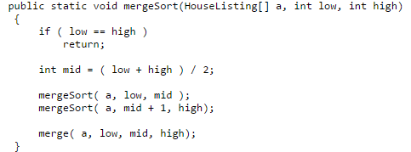
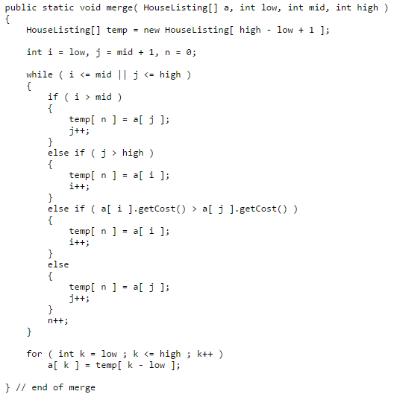

Slide 11
Searching Arrays
Searching is the process of looking for a specific element in an array;
For example, discovering whether a certain score is included in a list of scores.
Searching is a common task in computer programming.
There are many algorithms and data structures devoted to searching.
We are going o look at two commonly used approaches:
linear search
binary search
Binary search is much faster, but it requires a sorted list.

Slide 12
Linear Search
The linear search approach compares the key element, key, sequentially with each element in the list.
The method continues to do so until the key matches an element in the list or the list is exhausted without a match being found.
If a match is made, the linear search returns the index of the element in the array that matches the key.
If no match is found, the search returns -1.

Slide 13
Binary Search
For binary search to work, the elements in the array must already be ordered (sorted).
We will assume that the array is in ascending order.
e.g., 2 4 7 10 11 45 50 59 60 66 69 70 79
The binary search first compares the key with the element in the middle of the array.

Slide 14
Binary Search, cont.
Consider the following three cases:
If the key is less than the middle element, you only need to search the key in the first half of the array.
If the key is equal to the middle element, the search ends with a match.
If the key is greater than the middle element, you only need to search the key in the second half of the array.

Slide 15
Binary Search, cont.
The binarySearch method returns the index of the element in the list that matches the search key if it is contained in the list. Otherwise, it returns
-insertion point - 1.
The insertion point is the point at which the key would be inserted into the list.

Slide 16
Binary Search In Motion
/** Use binary search to find the key in the list */
public static int binarySearch(int[] list, int key) {
int low = 0;
int high = list.length - 1;
while (high >= low) {
int mid = (low + high) / 2;
if (key < list[mid])
high = mid - 1;
else if (key == list[mid])
return mid;
else
low = mid + 1;
}
return -1 - low;
}

